Slide 1

MLB Teams and the Probability of Playoffs
Grace Coccagna and Ryan Thompson

Slide 2
Introduction
Objective:
Identify key statistical thresholds that differentiate playoff and non-playoff teams in the MLB.
Use historical MLB data from Baseball Savant to determine which metrics are most influential in predicting playoff success.
Why This Matters:
Baseball analytics is a crucial tool for front offices.
Understanding performance benchmarks can guide roster decisions and player evaluations.

Slide 3

Methodology
Began with running a logistic regression, random forest, and gradient boosting to identify which metrics had the greatest impact in a team making the playoffs. These will be our Key Performance Indicators (KPI’s)
Then trained and built a predictive model with a 75-25 split
Our model could then predict the probability of a team making playoffs based on the given statistics with 93.33% accuracy
Built a model that allows you to input statistics in the KPI categories and it will print out your probability to make playoffs in the MLB.
Identified KPI thresholds for a team to qualify for playoffs.
Tested our model’s accuracy
Created visualizations

Slide 4
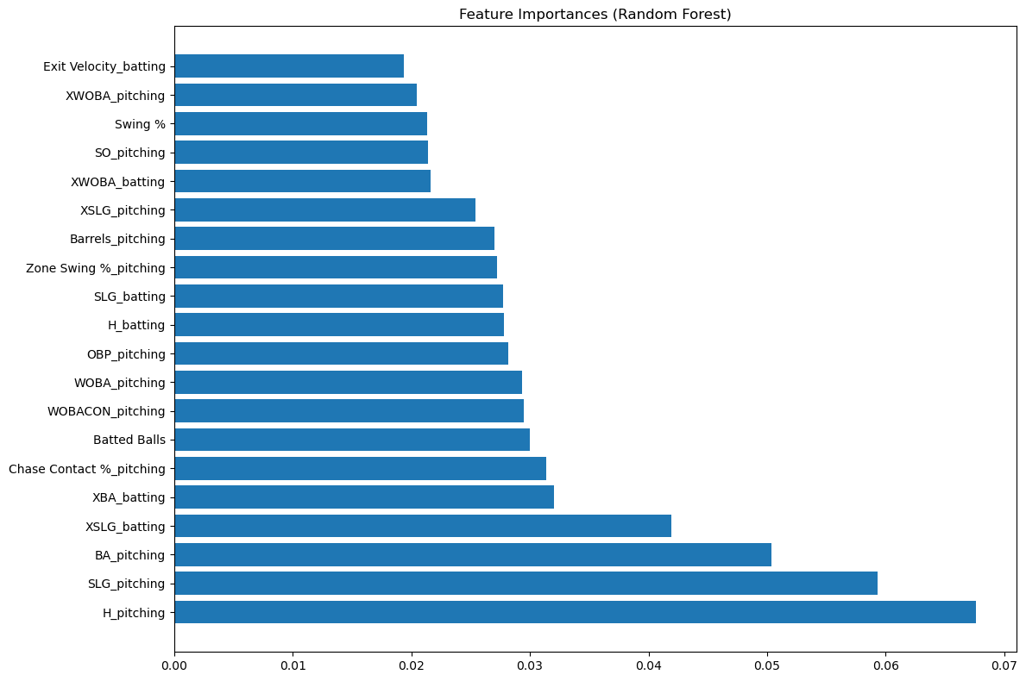

Slide 5
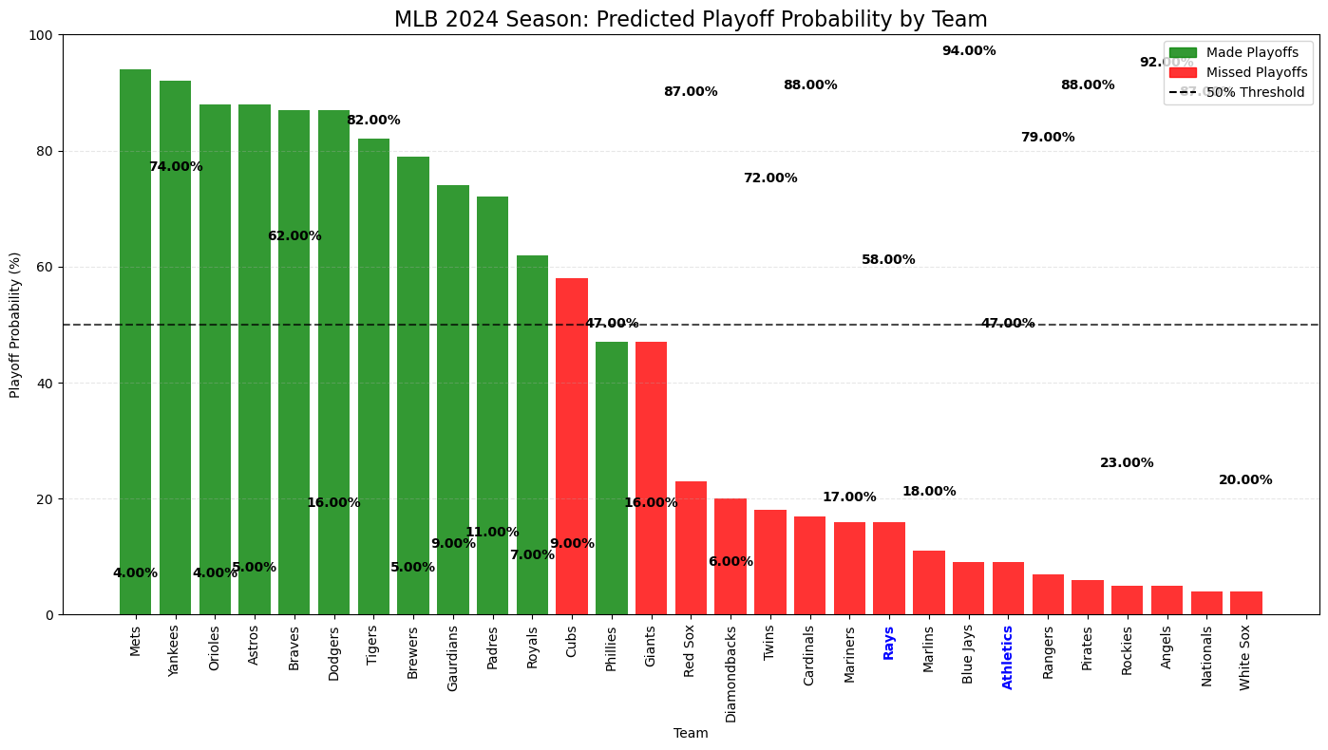

Slide 6
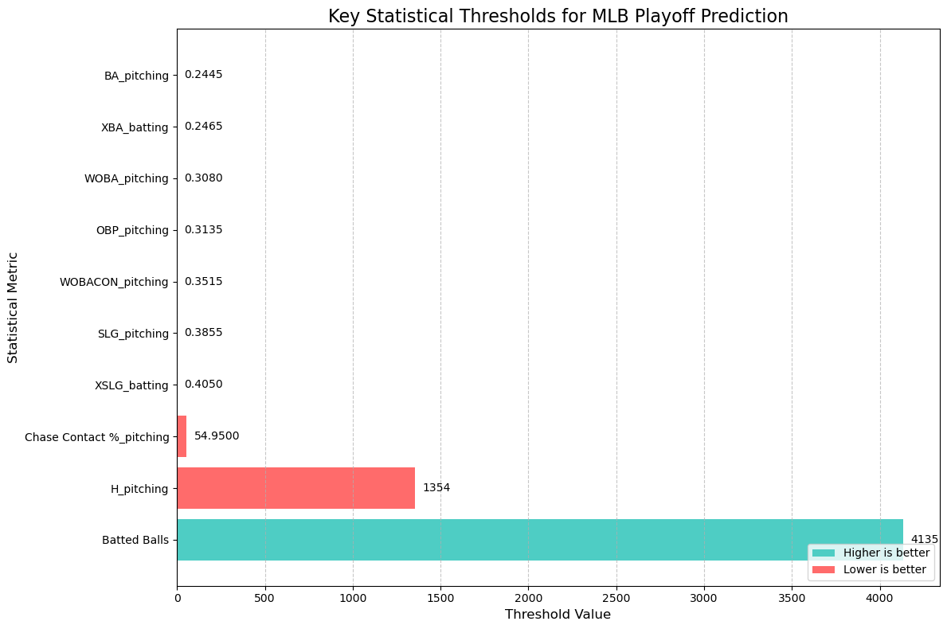

Slide 7
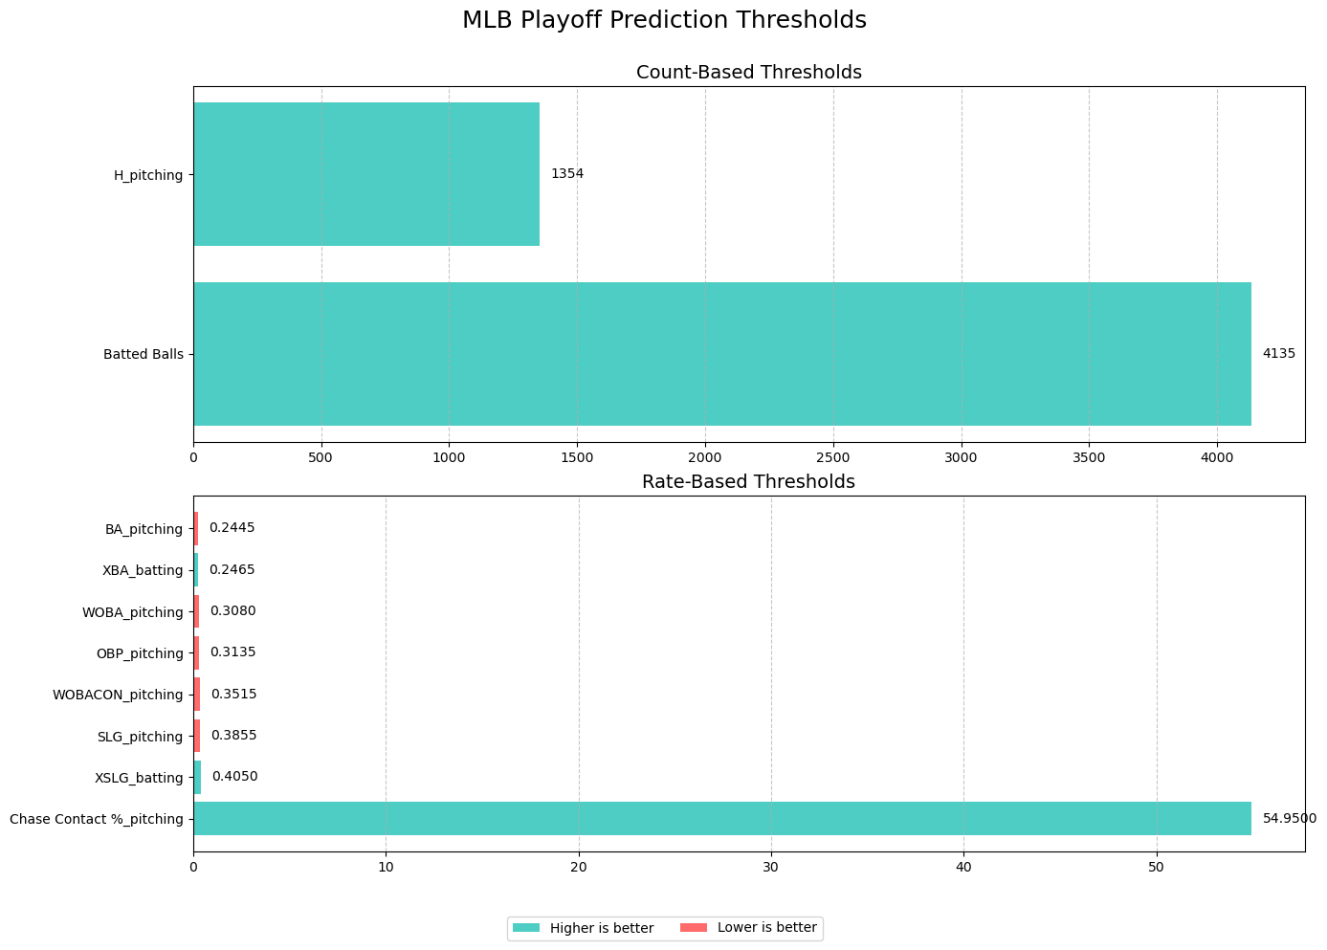

Slide 8
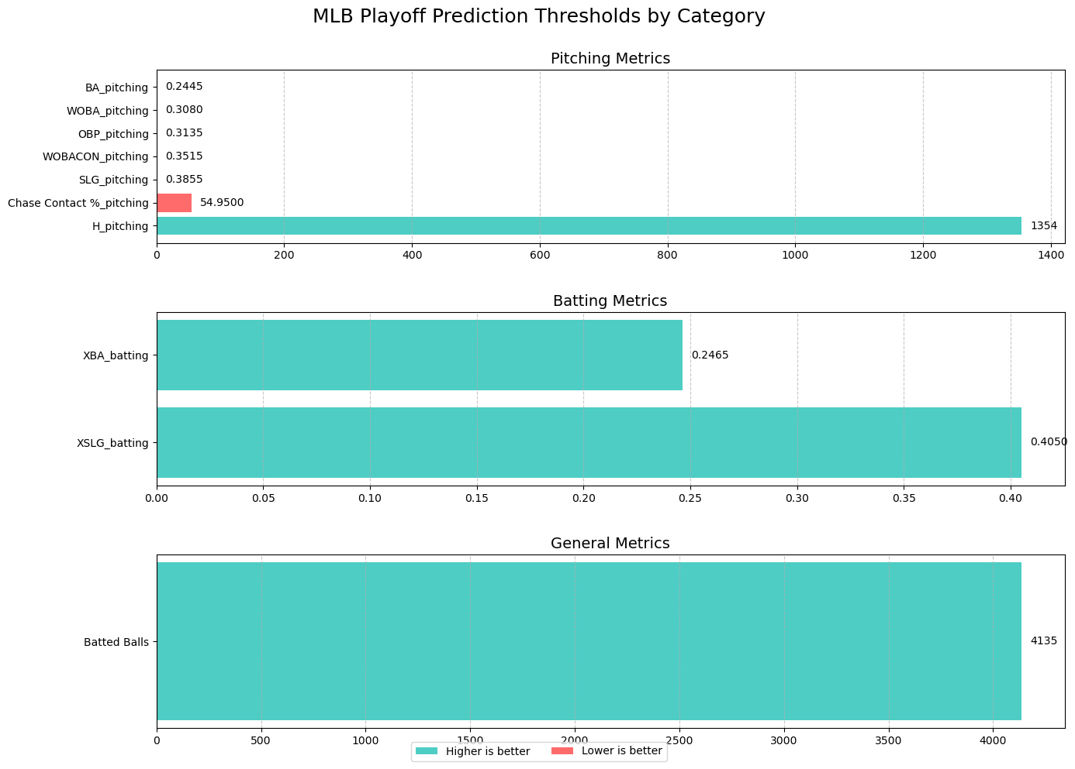

Slide 9
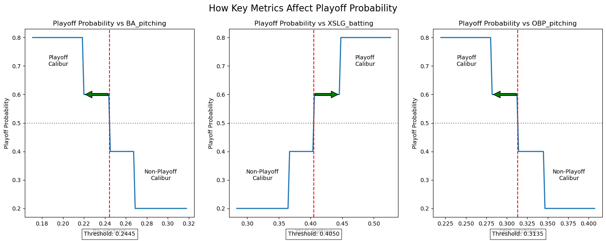

Slide 10
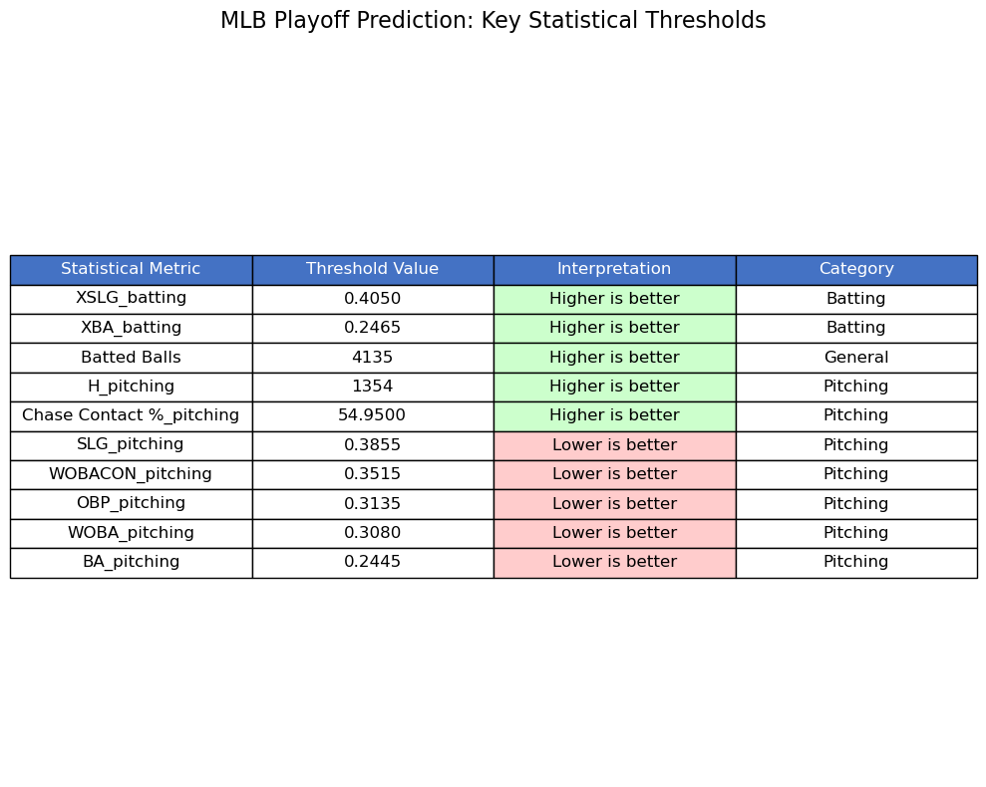

Slide 11
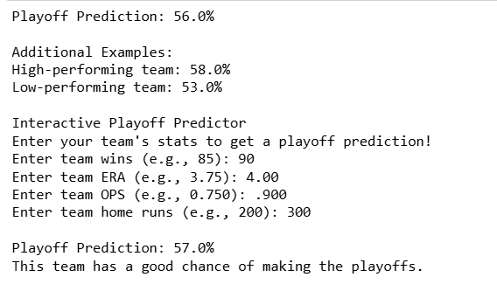
Example Data Probability Output

Slide 12
Ethical Considerations
Bias in Data & Decision-Making:
Over-reliance on historical data may undervalue intangibles like leadership, team chemistry, and clutch performance.
Risk of reinforcing inequalities in player evaluation, potentially overlooking players with unconventional success paths.
Transparency & Fairness:
Teams must balance analytics with fair player evaluations to avoid unfair roster decisions based solely on data.
Ethical use of analytics ensures players are not unfairly penalized for small sample sizes or systemic biases.
Data Privacy:
Advanced analytics often require biometric and performance tracking data—teams should ensure player consent and responsible use of data.

